Slide 1
Shortest Path in a graph
Dynamic Programming: Section 6.8 (Bellman-Ford Algorithm)

Slide 2
Problem
Given a directed Graph G = (E,V) with associated weights C_{ij} representing the cost for going from node i to j.
The algorithm looks for the shortest path from one node to all other nodes.

Slide 3
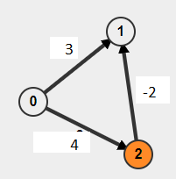
Why use bellman-Ford?
Even though Dijkstra’s algorithm is more efficient, there are more flexible and decentralized ways to finding the shortest path. (Aside from it’s failure to deal with negative edges).
Given the algorithm deals with negative cycles, it is applicable to arbitrage opportunities

Slide 4
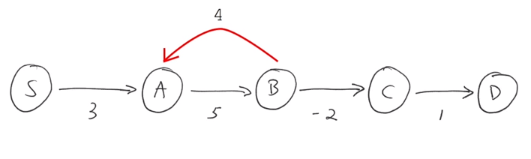
Theory
6.22 If G has no negative cycles, then there is a shortest path from s to t that is doesn’t repeat nodes, and hence has at most n-1 edges.

Slide 5
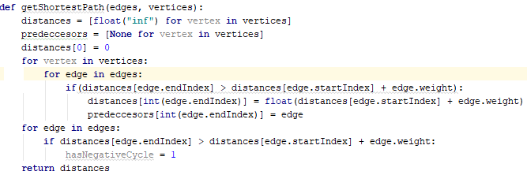
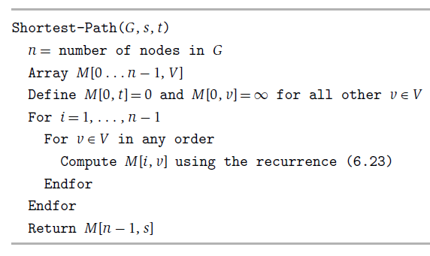
Pseudocode

Slide 6
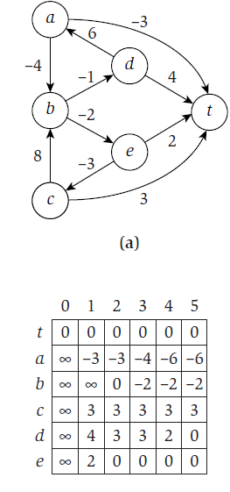
Running through the algorithm
1st iteration: d
2nd iteration: d-t
3rd iteration: d-a-t
4th iteration: d-a-b-e-t
5th iteration: d-a-b-e-c-t

Slide 7
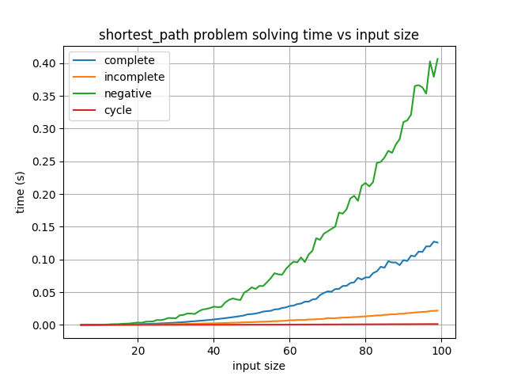
Generators Graph Output:

